Slide 1
oCT 31 2024
Kilimo Score
YOUR TRUST, YOUR CAPITAL.
Jenga Uwezo, Pata Mkopo
AI 4 STARTUPS

Slide 2
The Unscored Farmer
70% of smallholder farmers in Kenya are systemically excluded from formal credit
Why? Lenders rely on traditional data (bank statements, credit bureau scores) that >60% farmers just do not have.
This creates a barrier to capital for essential inputs like seeds and fertilizer, locking them in a cycle of debt and low productivity.
KILIMO SCORE
AI 4 START UPS

Slide 3
Introducing Kilimo Score
We're not building another traditional credit score. We've built a Holistic Trust Score that asks a better question
Old Way: "What is this farmer's financial history?”
Our Way: "What is this farmer's production potential and reliability?"
This allows us to score any farmer, regardless of their financial history, and unlock inclusive financing
KILIMO SCORE
AI 4 STARTUPS

Slide 4
OUR KEY INNOVATIONS
A Win-Win-Win Platform
Kilimo Score is not just a model; it's a complete ecosystem designed for your key stakeholders.
FOR THE FARMER
FOR THE LENDER
FOR THE ECOSYSTEM
”A Path to Yes“
”A Dynamic Risk Tool.“
”A Fair & Inclusive Scoring System.“
Transparent Feedback: We aim to tell farmers why they were denied, in simple language.
Score the "Unscorable": We create a verifiable trust score from alternative data, opening up a new, high-potential market.
Removes Systemic Bias: our model is inherently more Equitable and inclusive.
KILIMO SCORE
AI 4 STARTUPS

Slide 5
OUR INSIGHT
Data is Everywhere - but is underutilised
Our Solution fills this gap by combine four alternative data sources:
Satellite Data (NDVI): We use NDVI, derived from satellite imagery, to measure crop health. This is a direct, unbiased proxy for a farmer's skill and future income.
Climate Data (KMD): We integrate historical rainfall, seasonal forecasts, and drought/flood alerts from the Kenya Meteorological Department.
Agricultural Data (KilimoSTAT): We use county-level data on crop yields, soil types, and market prices from KilimoSTAT and KALRO.
Psychometric Data (SACCOs): We feature if a farmer is part of a local SACCO, which is a strong proxy for reliability.
KILIMO SCORE
AI 4 STARTUPS

Slide 6
DEMO
LIVE DEMO: From "NO" to "A Path to Yes"
KILIMO SCORE
AI 4 STARTUPS

Slide 7
M
MARKET
MARKET
MARKET
MAR
OUR ROADMAP
From Model to Market
MARKET
MODEL
MODE
This 3-day hackathon is just the start.
MODEL
Next 3 Months (Pilot): We will partner with a Kenyan SACCO or MFI to pilot Kilimo Score with a small group of farmers, refining our model with real-world repayment data.
Next 6 Months (Scale):We will integrate live satellite data feeds, automate our data pipelines from KMD and KilimoSTAT, and expand our model to new crops and counties.
Our Vision (Impact):To become the standard for fair and transparent agricultural financing in East Africa—unlocking affordable and inclusive capital for millions of smallholder farmers.
MODEL
M
MODEL
MODEL
MODEL
MOD
MODEL
MODEL
MODEL
KILIMO SCORE
AI 4 STARTUP
MODEL
MODEL

Slide 8
BUSINESS & GO-TO-MARKET
Business Model
We are a B2B PaaS & SaaS .
Our customers are: banks, MFIs, Saccos, and agri-lenders .
Revenue Streams: API Calls($0.10-$0.25), Analytic Dashboards and Premium Insights
We help them de-risk their portfolios and unlock an untapped new market.
KILIMO SCORE
AI 4 STARTUPS

Slide 9
IMPACT
Impact & Sustainability
Our project is designed to create a virtuous cycle of growth and financial inclusion, directly aligning with key SDG goals
SDG 1: NO POVERTY
By unlocking credit, we enable farmers to increase their income.
SDG 2: ZERO HUNGER
Farmer investments lead to better food security and productivity.
SDG 8: ECONOMIC GROWTH
We are building a more robust and inclusive rural economy.
SDG 10: REDUCE IN EQUALITIES
Our system provides fair access to capital.
SDG 13: CLIMATE ACTION
We mitigate financial barriers to climate adaptation on the farm
KILIMO SCORE
AI 4 STARTUPS

Slide 10
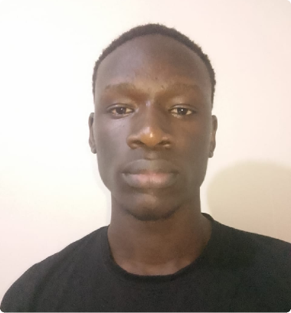

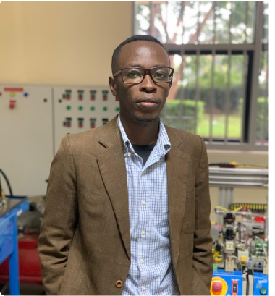


OUR TEAM
Victor · Full Stack Developer
Abraham · Agric/Climate Advocate
Alvin · Embedded Systems
PREVIOUS COMPANIES
Alex · Sustainability Adviocate
Nahadi · AI/ML
KILIMO SCORE
AI 4 STARTUP

Slide 11
ASK?
The Ask?
Total Ask: KES 2,500,000 ($19,200 USD).
Runway: 3 Months.
Core Goal: Deploy "Kilimo Score " and secure our first institutional partner to validate the model.
Funding Allocation (Prioritizing Product)
45% - Product: API hardening & building the partner integration framework.
30% - Operations: 3-month admin, compliance, and contingency buffer.
15% - Data & Activation: Geo-Data license Aquisition/Renewal & securing the anchor partner.
10% - Talent: 3-month talent & hiring for final validation
KILIMO SCORE
AI 4 STARTUPS

Slide 12
Thank you!
Join us in redefining how Africa’s undeserved farmers are seen, scored and financed
KILIMO SCORE.

